Slide 1
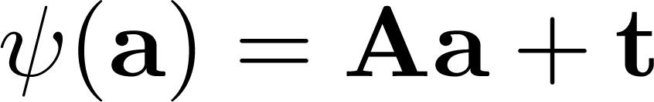

Rigid body motions
(Euclidean transformations / isometries)
Theorem: Any rigid body motion can be expressed as an orthogonal transformation followed by a translation.

Slide 2
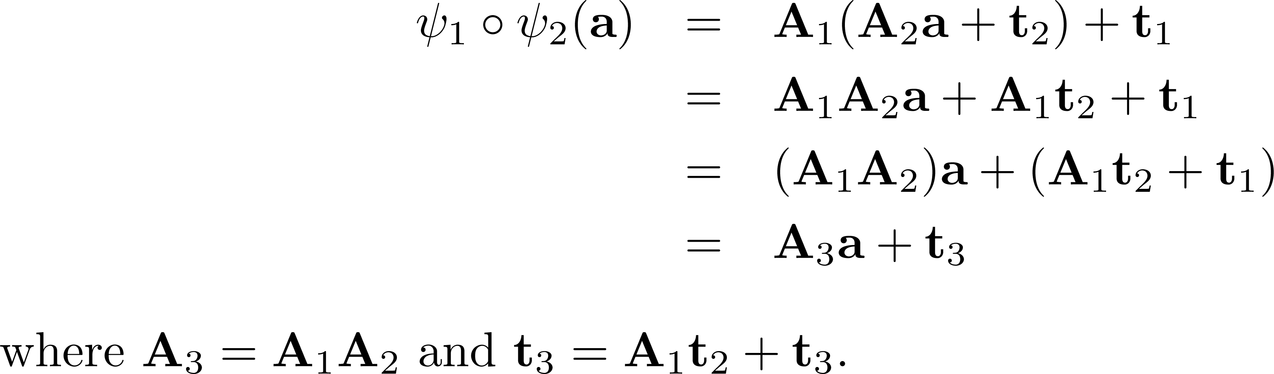

The composition of two isometries is an isometry

Slide 3
Affine transformations
Definition: An affine transformation is a nonsingular linear transformation followed by a translation.

Slide 4
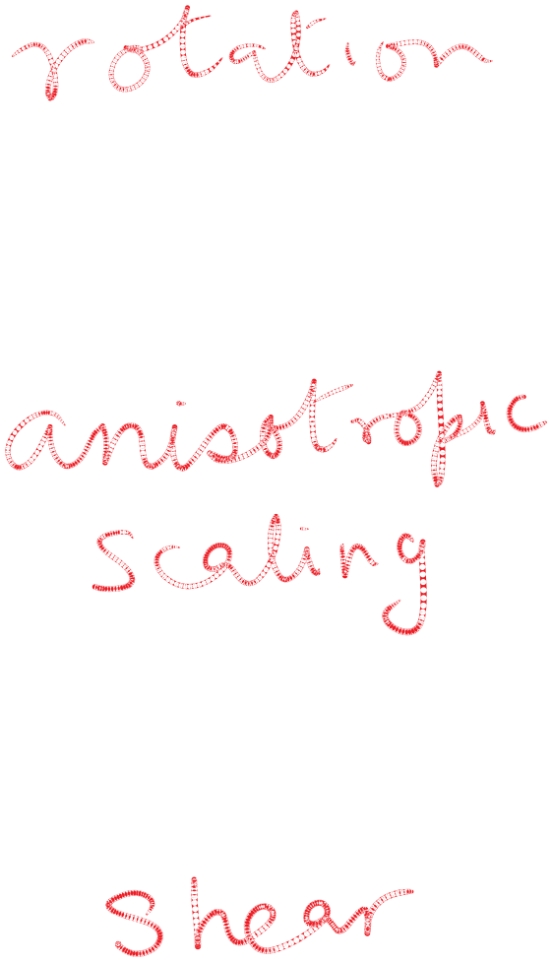
Some examples of affine transforms…

Slide 5
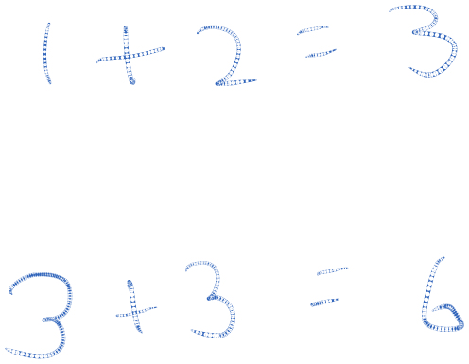
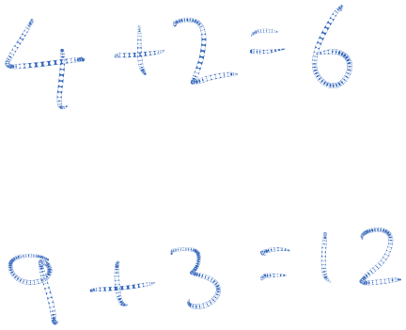
Number of parameters required to specify isometry vs. affine transform
In 2D
In 3D

Slide 6


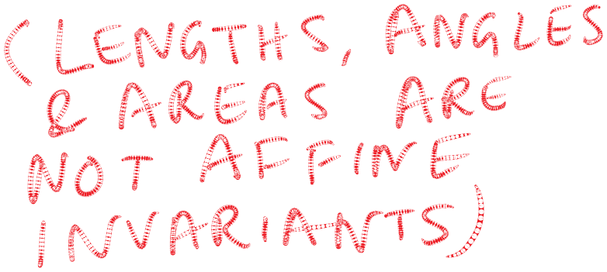
Invariants under transformation
(Properties that remain unchanged)
Lengths
Angles
Area
…
Parallelism
Midpoints

Slide 7
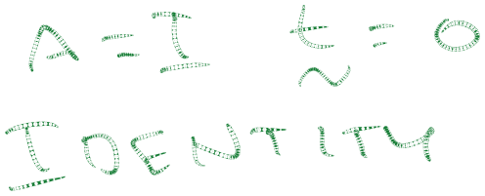
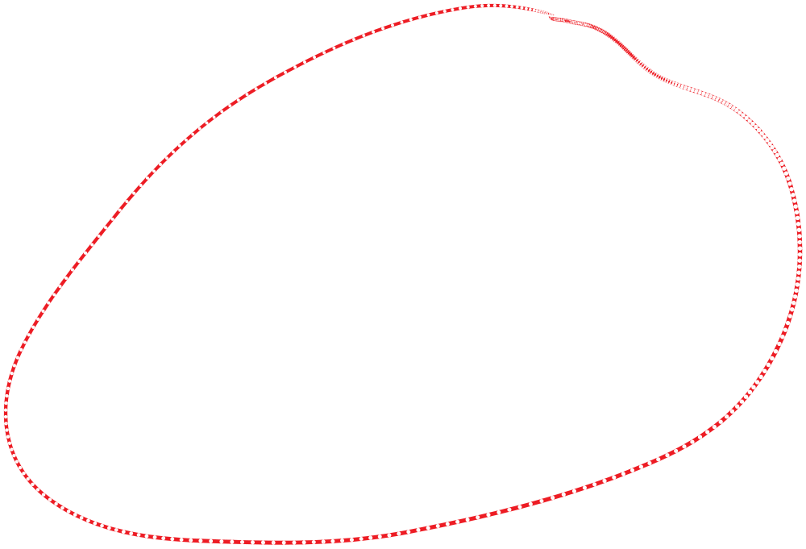



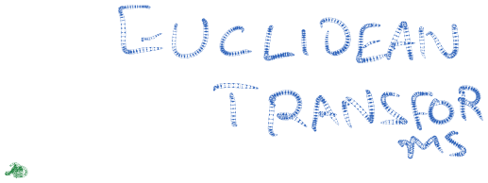
The big picture ...
But are affine transforms as general as we need to be?

Slide 8
Projective Transformations
Under perspective projection, parallel lines can map to lines that intersect. Therefore, this cannot be modeled by an affine transform!
Projective transformations are a more general family which includes affine transforms and perspective projections.
Projective transformations are linear transformations using homogeneous coordinates

Slide 9
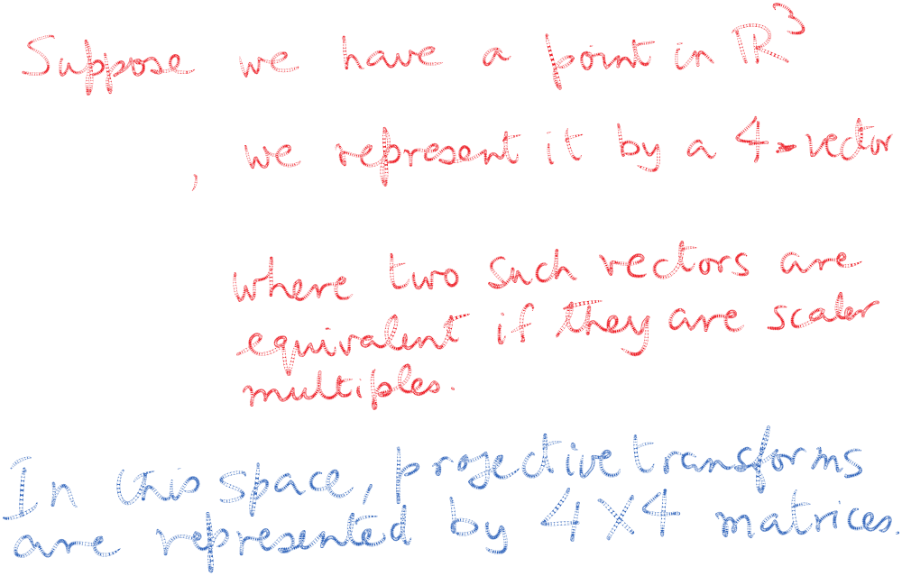
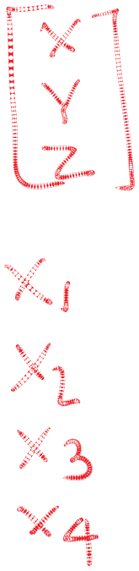


Homogeneous coordinates
(look up on Wikipedia)

Slide 10
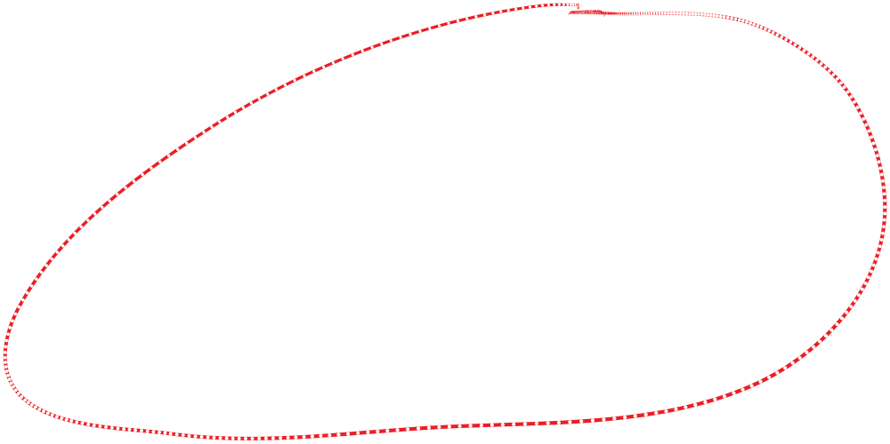
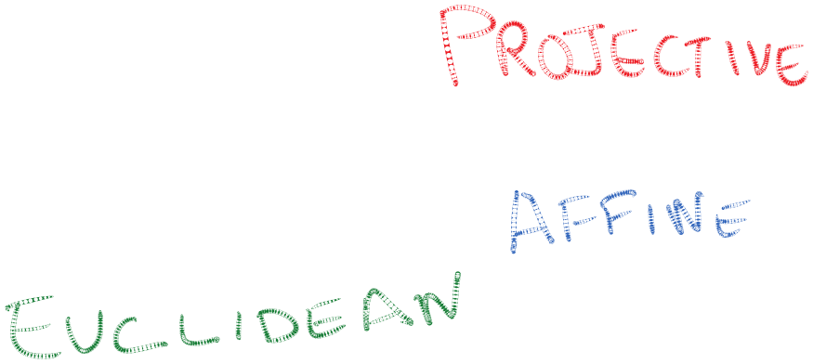
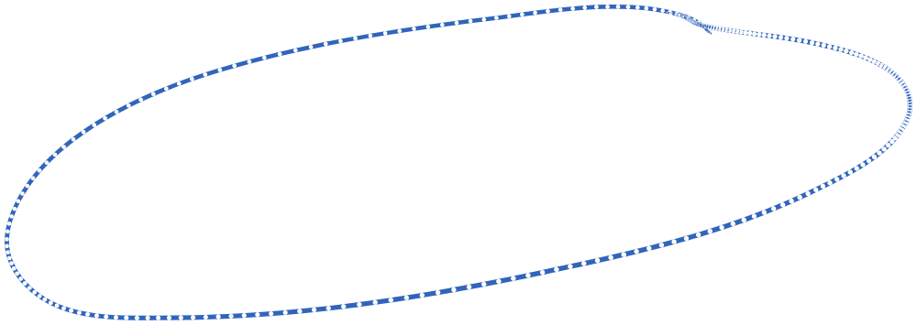
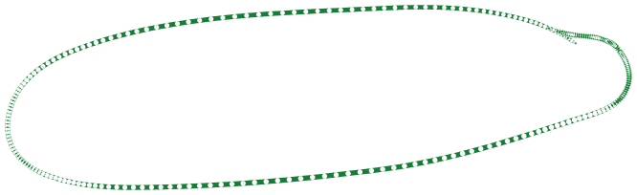
The final story…

Slide 11
